Slide 1

What parents should know
about eating disorders
Erin C. Accurso, PhD
Clinical Director
Associate Professor
Psychologist + Mom
UCSF Eating Disorders Program

Slide 2
Disclaimers + Principles
I don’t specialize in feeding/eating disorders in really young children.
I’m continuing to learn and make lots of mistakes along the way.
Every child + family is unique and will apply these principles in their own way .
We all come to the table with our upbringing, cultural background, experiences influencing our beliefs + behaviors that impact parenting. Awareness of these is ever evolving.
You might have heard different things… it’s normal to experience dissonance.
Self-compassion is key in parenting (and in general…!).

Slide 3
Outline
Understand influences on our beliefs/behaviors in the realm of nutrition, eating and body image
Eating disorder risk factors and warning signs
Discuss principles that can help build healthier body image and relationship with eating/food
Questions/discussion

Slide 4

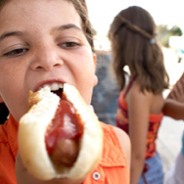
What is healthy eating?
Flexibility in food choices
No foods are “off-limits”
Listening to hunger and fullness
“No food is healthy when you aren’t healthy about how you’re eating it”

Slide 5
“Normal eating is going to the table hungry and eating until you are satisfied. It is being able to choose food you like and eat it and truly get enough of it—not just stop eating because you think you should. Normal eating is being able to give some thought to your food selection so you get nutritious food, but not being so wary and restrictive that you miss out on enjoyable food…. It is leaving some cookies on the plate because you know you can have some again tomorrow, or it is eating more now because they taste so wonderful…. Normal eating is trusting your body to make up for your mistakes in eating. Normal eating takes up some of your time and attention but keeps its place as only one important area of your life.”
-Ellyn Satter

Slide 6
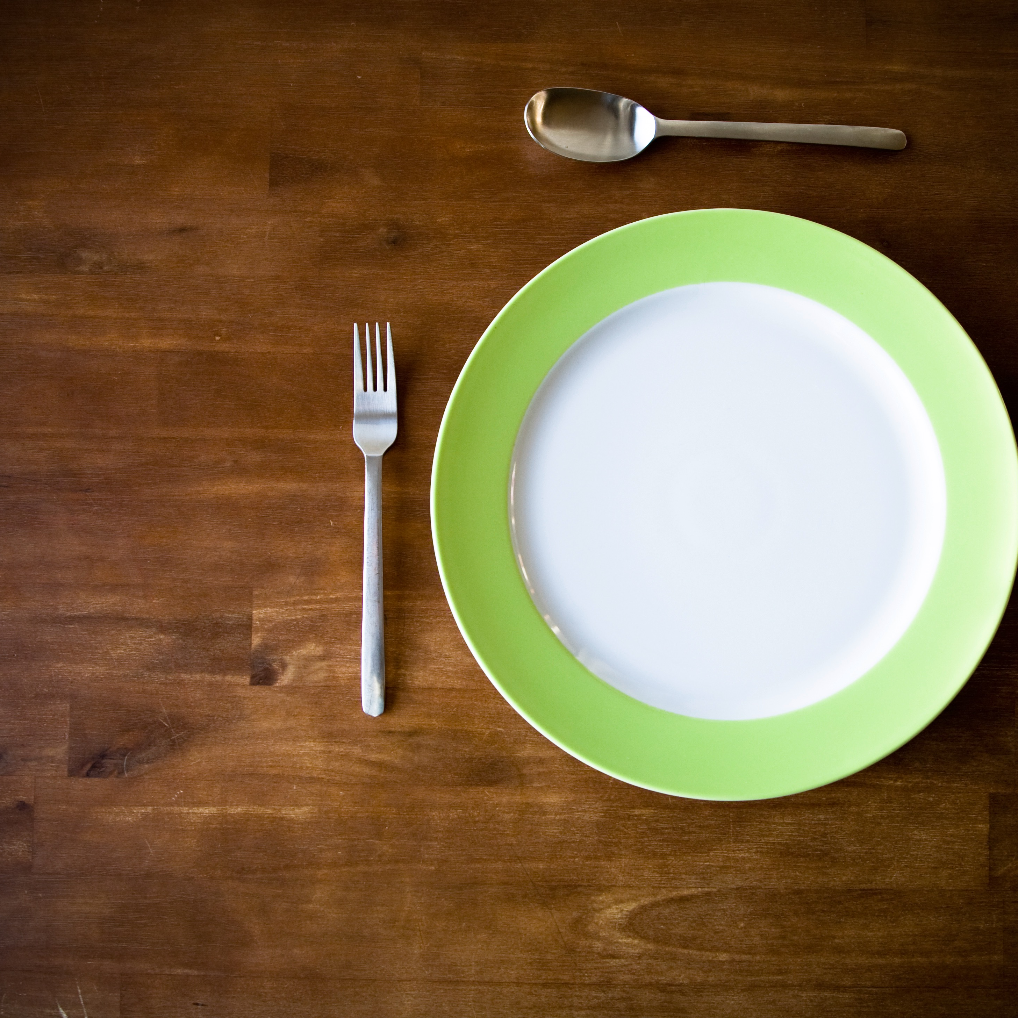
What is disordered eating?
Disordered eating is when a person’s attitudes about food, weight, and body size lead to very rigid eating and exercise habits that jeopardize one's health, happiness, and safety.

Slide 7
Healthy eating and attitudes
Disordered eating and attitudes
Food is enjoyable
Food is fuel
Food flexibility
Guilt-free eating
Trust in physical cues/body
Value attached to food (good/bad)
Controlling food = sign of virtue
Guilt with eating
Following rigid rules/diet culture + depriving self
Over-use of food as primary coping mechanism for emotions and stress

Slide 8
What is an eating disorder?
An eating disorder is an abnormal eating pattern that compromises physical health and emotional well-being
Eating disorders include:
  Anorexia Nervosa
  Bulimia Nervosa
  Binge Eating Disorder
  ARFID
  and variations of all of the above!

Slide 9
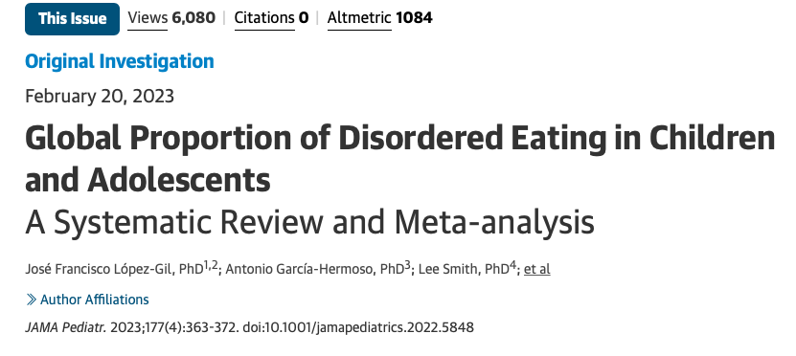
In this systematic review and meta-analysis of 32 studies including 63,181 participants from 16 countries, 22% of children and adolescents had disordered eating. The proportion was further elevated among girls, older adolescents, and those with higher body mass index.

Slide 10
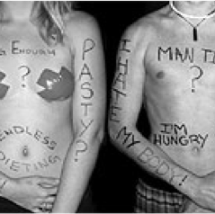
The state of dieting
40% of 9 year-old girls have dieted
40-60% of high school girls
“I can’t eat that. I need to lose weight for [insert event]” or “I can’t eat that because I’m on a diet.”

Slide 11
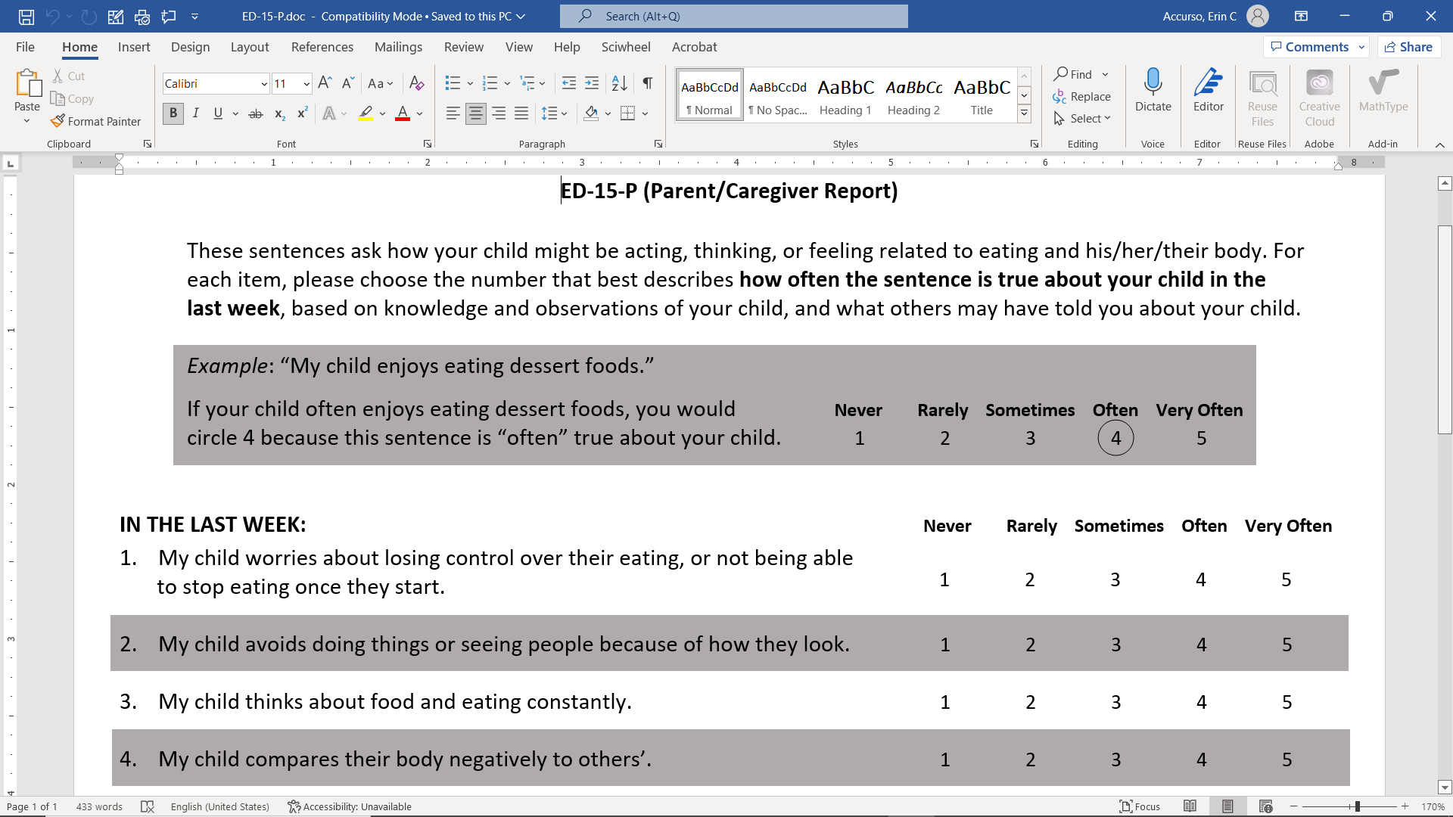

Slide 12
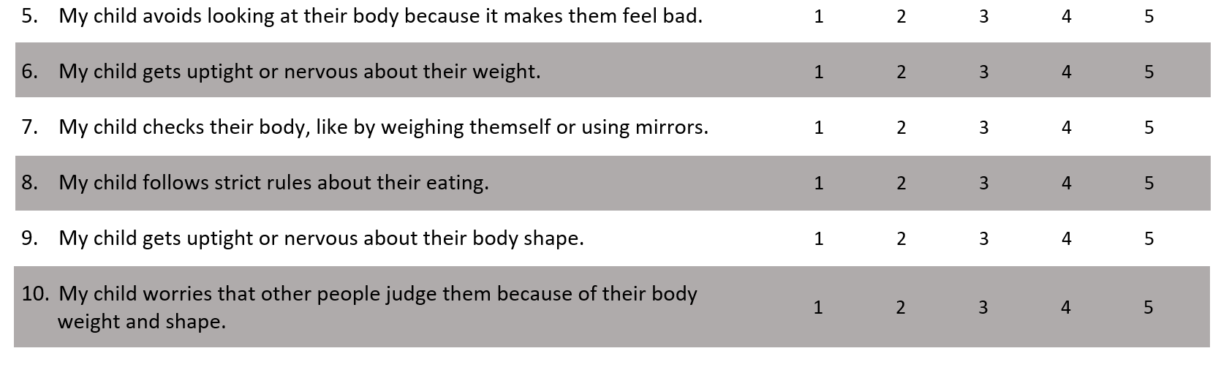
When completed by a parent whose child/adolescent is diagnosed with an eating disorder, the average score on this measure is 3.0, with a typical range of 2-4 (i.e., 70% of parents of children with an eating disorder have a score between 2.0 and 4.0).

Slide 13
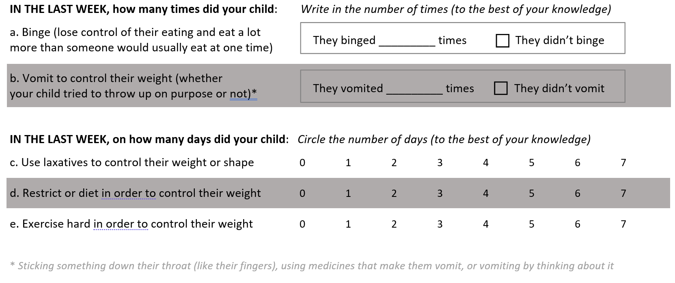
Any one of these behaviors could indicate cause for concern. Start with having a conversation about it.

Slide 14
Eating Disorder Myths
They only happen to girls
It’s just a phase
It’s all about attention
They only happen in middle to upper class White families
People never really recover from an eating disorder
Parents are to blame
They are caused by the media

Slide 15

Eating disorders transcend race, ethnicity, gender identity, sexual orientation, age, socioeconomic status, body shape or size…

Slide 16
There are as many reasons why people develop eating disorders as there are people with eating disorders… there is NO single cause

Slide 17
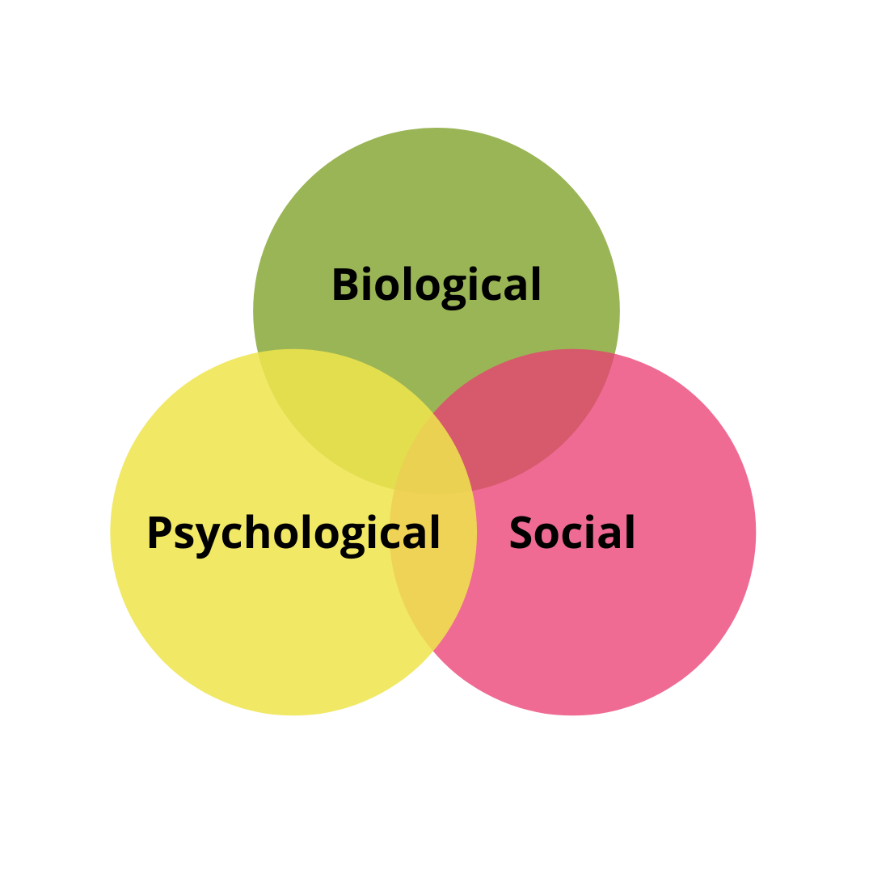
What causes eating disorders?

Slide 18

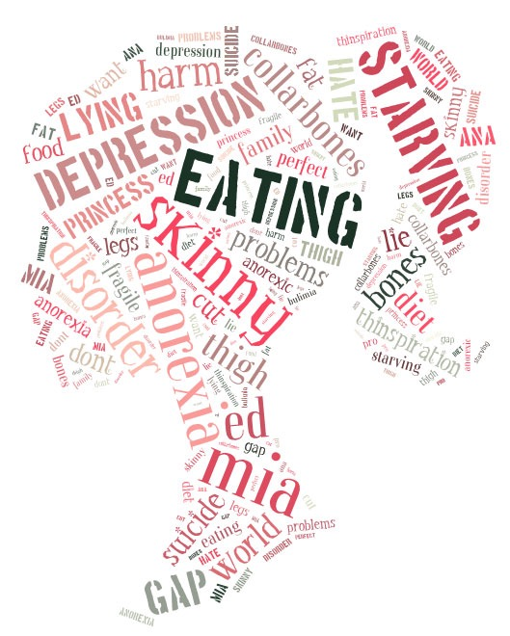
Risk Factors
Established Risk Factors:
Frequent dieting/restrictive eating
Extreme preoccupation with body weight/shape
Potential Risk Factors/Correlates:
Weight loss, failure to make weight gain
Compulsive exercise
Binge Eating
Purging
Perfectionism
Family history

Slide 19
Factors that increase risk
Age (95% of EDs develop between 12-25 years)
Body image dissatisfaction/ internalization of thin ideal
Teased or criticized about weight
Participating in a sport/activity that prioritizes low weight
Negative energy balance (can be accidental)
GI & infection
LGBTQ+
Trauma

Slide 20
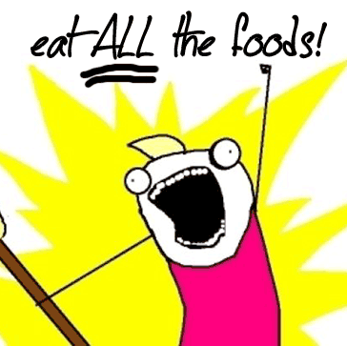
Diet Culture
Dieting is a temporary change in eating habits, most often to lose weight, or to maximize athletic performance
Diet culture normalizes the practice of dieting
*Photo credit of Allie Brosh Hyperbole and a Half

Slide 21
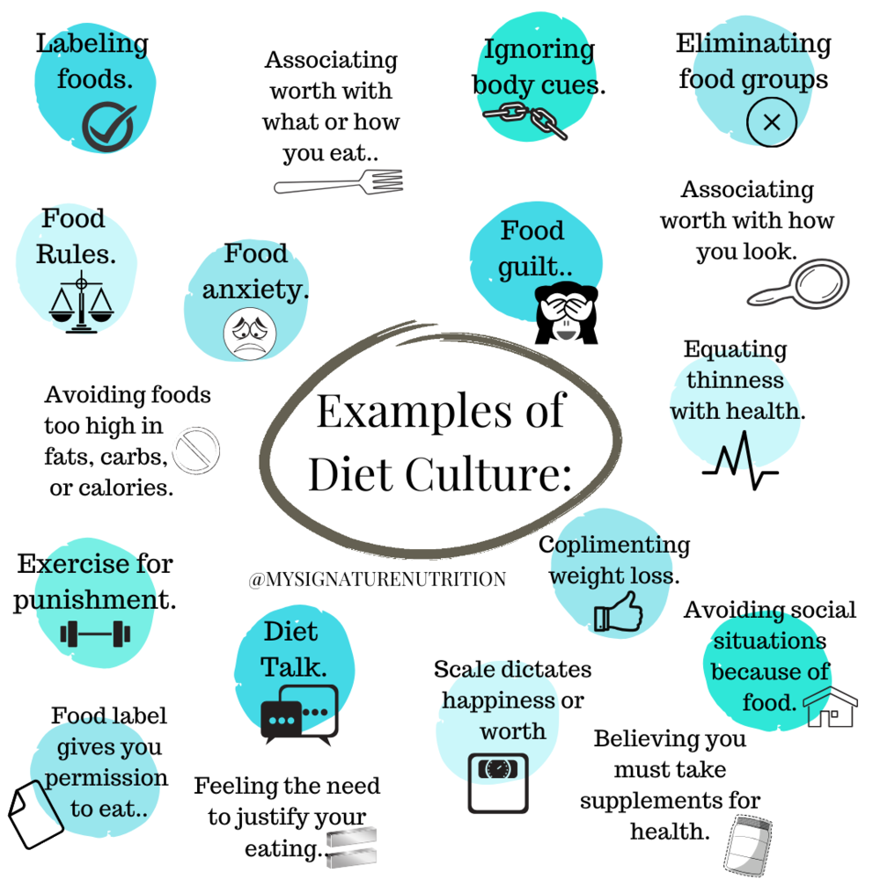
Diet culture
Idealizing Thinness + equating with health + virtue
Encourages investment of time + money in pursuit of this ideal (who profits?)
“Right + wrong” ways of eating
Contributes to oppression of already marginalized groups
Notes:
Think about your own relationship with food/body? How does this manifest in your behavior/what you model for your child? “I’m trying to be “good” so I wont eat that”, “Going to need to hit the gym to burn that meal off!” “Probably gained 5lbs eating that meal” “She really shouldn’t be wearing that outfit” (someone in larger body)

Slide 22
Dieting has become normalized, but is NOT a NORMAL way of eating
Diets don’t work:
  More likely to cause weight gain than long term weight loss (only 5% keep weight off)
  Often poor scientific evidence to support diet claims
  One of the most powerful predictors of disordered eating

Slide 23
Dieting has become normalized, but is NOT a NORMAL way of eating
Diets are often harmful:
  Nutrient deficiencies, injury, lower immunity
  Dieting is one of the most common and preventable precursors to developing an eating disorder
  One of the most powerful predictors of disordered eating

Slide 24
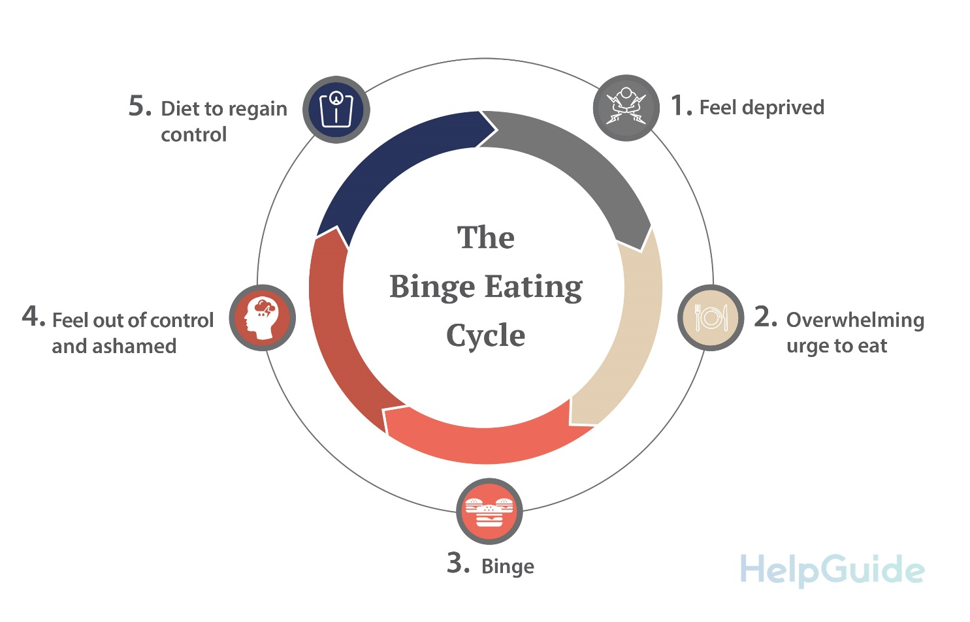
What else is wrong with diets?
Increase preoccupation with food (especially forbidden foods)
Deprivation → overeating/bingeing → restrict/overeat cycle
Promotes false idea that weight loss = healthy

Slide 25
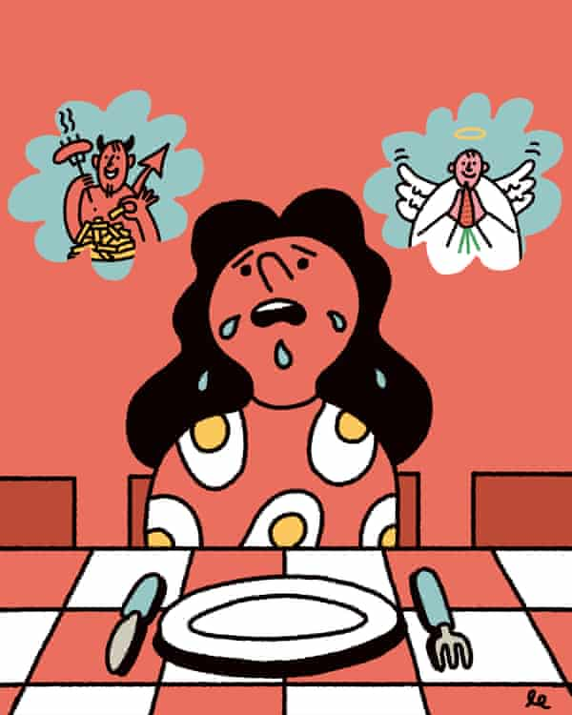
What else is wrong with diets?
Reinforces thin ideal
Moralizes food choices (good/bad)
Makes us distrust our bodies
Makes us believe we are the problem (when a diet doesn’t work)

Slide 26
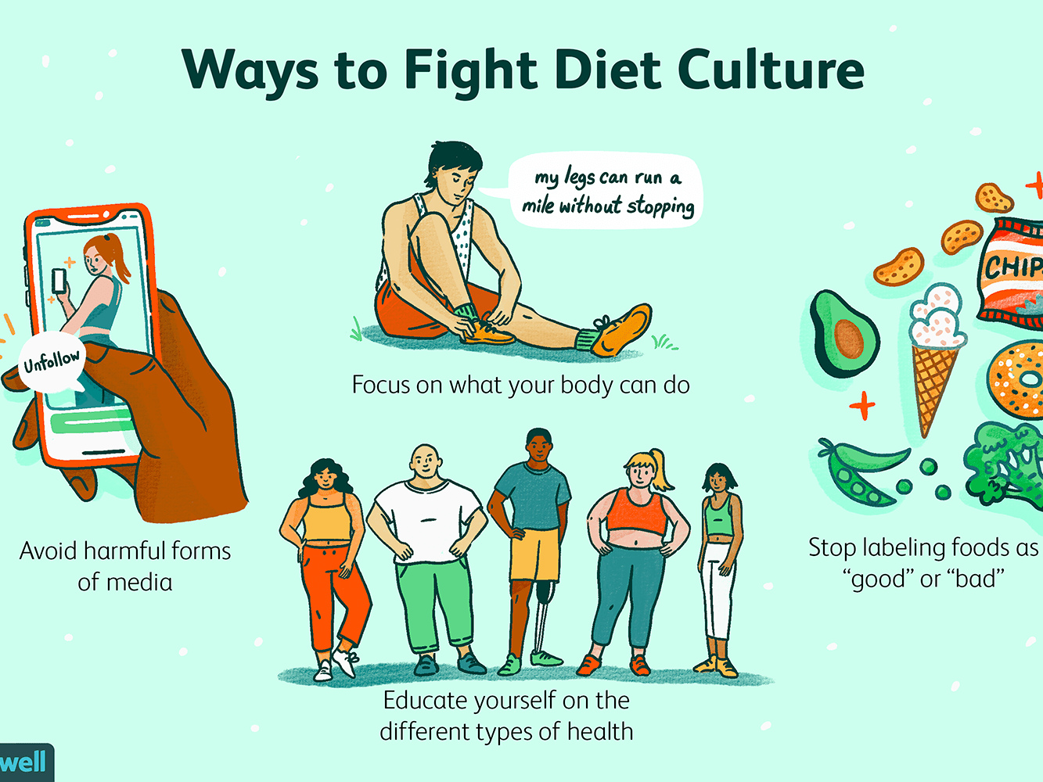
Educate and dismantle
Make a commitment to learn about diet culture + anti-fat bias - how has it impacted your relationship with your body/food?

Slide 27
Let’s take a moment for reflection on what you’ve just heard about diets and dieting

Slide 28
Many risk factors can be changed!
Negative energy balance/frequent dieting
Body image dissatisfaction
Personality traits: perfectionism, low self-esteem, rigid thinking
Exposure to negative images & messages about food and body

Slide 29
Principles & Pointers
Trust your child’s innate capacity to self-regulate
Refrain from using food as a bribe or punishment
  “You can have dessert, but only if you finish your broccoli.”
  “If you don’t help clean up the dishes, no more cookies.”
Avoid restricting access to foods
  This is associated with eating in absence of hunger, body dissatisfaction, restrictive eating disorders, loss of control eating, weight gain outside of normal growth + development

Slide 30
Principles & Pointers
Encourage eating a wide range of food – prepare in new ways/find preparations your kid likes, present consistently, praise trying new things/food openness
Remember that our bodies get nutrients they need over days/weeks. Give options (within reason)
Allow kids to be involved in cooking and serving food
Ask your pediatrician to avoid discussing weight + BMI in front of your children

Slide 31
Practice Body Respect
Address weight/shape-based bullying/interrupt fat-talk
Normalize bodies of different shapes, sizes and abilities
Remember that weight/BMI is not a good predictor of health – focus on supporting growth + development for each individual’s body type
Remember that body composition is largely genetically determined
Model positive body image
Focus on moving for fun, joy, self-efficacy

Slide 32
Responding to “fat” or “diet” talk
“Your body is really smart and knows what it needs”
“All bodies are different/unique”
“Your body knows what it needs to be the shape/size that’s just right for you”

Slide 33

Early Warning Signs
Rigid rules - only “healthy foods”, no carbs, sugar
Skipping meals, ignoring hunger
Eating past fullness on a regular basis/feeling unable to stop
Feeling guilty for eating
Trying to compensate or “negate” eating by exercising, purging, taking diet pills or laxatives
Making negative comments about body
Food goes missing
Consistent use of bathroom after meals

Slide 34
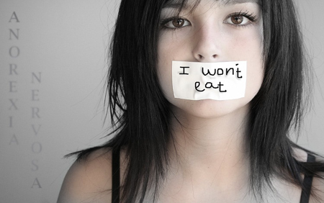
Later Signs
Weight loss or lack of growth (no weight loss in young pts)
Loss of menses
Ill fitting clothes
Seldom seeing your child eat much or anything
Isolating from peers
Vast quantities of food missing, or food wrappers found in bedroom
Tooth decay/strange color/swollen parotids, or calluses on hands

Slide 35
Medical complications
Changes in heart rate, blood pressure, and temperature are due to malnutrition and/or weight loss
Can see abnormalities in normal or overweight tweens/teens with inadequate nutrition, not just those who are technically underweight!
Compromises growth and development: bones, brain, organs are still growing

Slide 36
Emotional/cognitive consequences
More irritability, anxiety, low mood
Social isolation
Low self-worth
Thinking about food/eating/calories for much of the day
Body image distortion

Slide 37
How to know when it’s a problem
Is it negatively impacting your child’s physical health?
  Weight + symptom frequency
Is your child’s head space (e.g., ability to concentrate, self-esteem, mood) consumed with thinking about their body or food?
Is it getting in the way of their life?
Are they spending too much time working out, or avoiding social events for food related reasons?

Slide 38

What can you do?
Remain open to the possibility - denial is an eating disorder’s best friend
Trust your instincts
Encourage neutral commentary around food and weight/shape

Slide 39
What can you do?
Be curious, listen without judgment
Seek early and complete evaluation from your pediatrician or a specialist
Talk to your child about your concerns

Slide 40
Parents are the best resource
Share your concern with your adolescent EARLY
Seek specialized care (provider or program should have expertise in eating disorders), and know that evidence-based treatments almost ALWAYS include caregivers/parents
Family-based treatments have the strongest evidence and are the recommended first-line approach
Early intervention leads to improved recovery
Focus on addressing immediate symptoms, not underlying cause

Slide 41
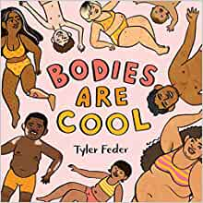
Resources
Books
How to Raise an Intuitive Eater by Brooks & Severson
Help Your Teenager Beat an Eating Disorder by Lock & Le Grange
I’m like SO fat: Helping Your Teen Make Healthy Choices about Exercise and Eating in a Weight Obsessed World by Neumark-Stzainer
Bodies are Cool by Tyler Feder
Podcasts
Food Psych with Christy Harrison
Maintenance Phase with Aubrey Gordon & Michael Hobbes

Slide 42
Helpful Websites
Maudsley Parents (maudsleyparents.org)
F.E.A.S.T. (feast-ed.org)
UCSF Eating Disorders Program (eatingdisorders.ucsf.edu)
National Eating Disorders Association (NEDA.org)
The Full Bloom Project: Body positive parenting (fullbloomproject.com)
Ellyn Satter Institute (ellynsatterinstitute.org)

Slide 43
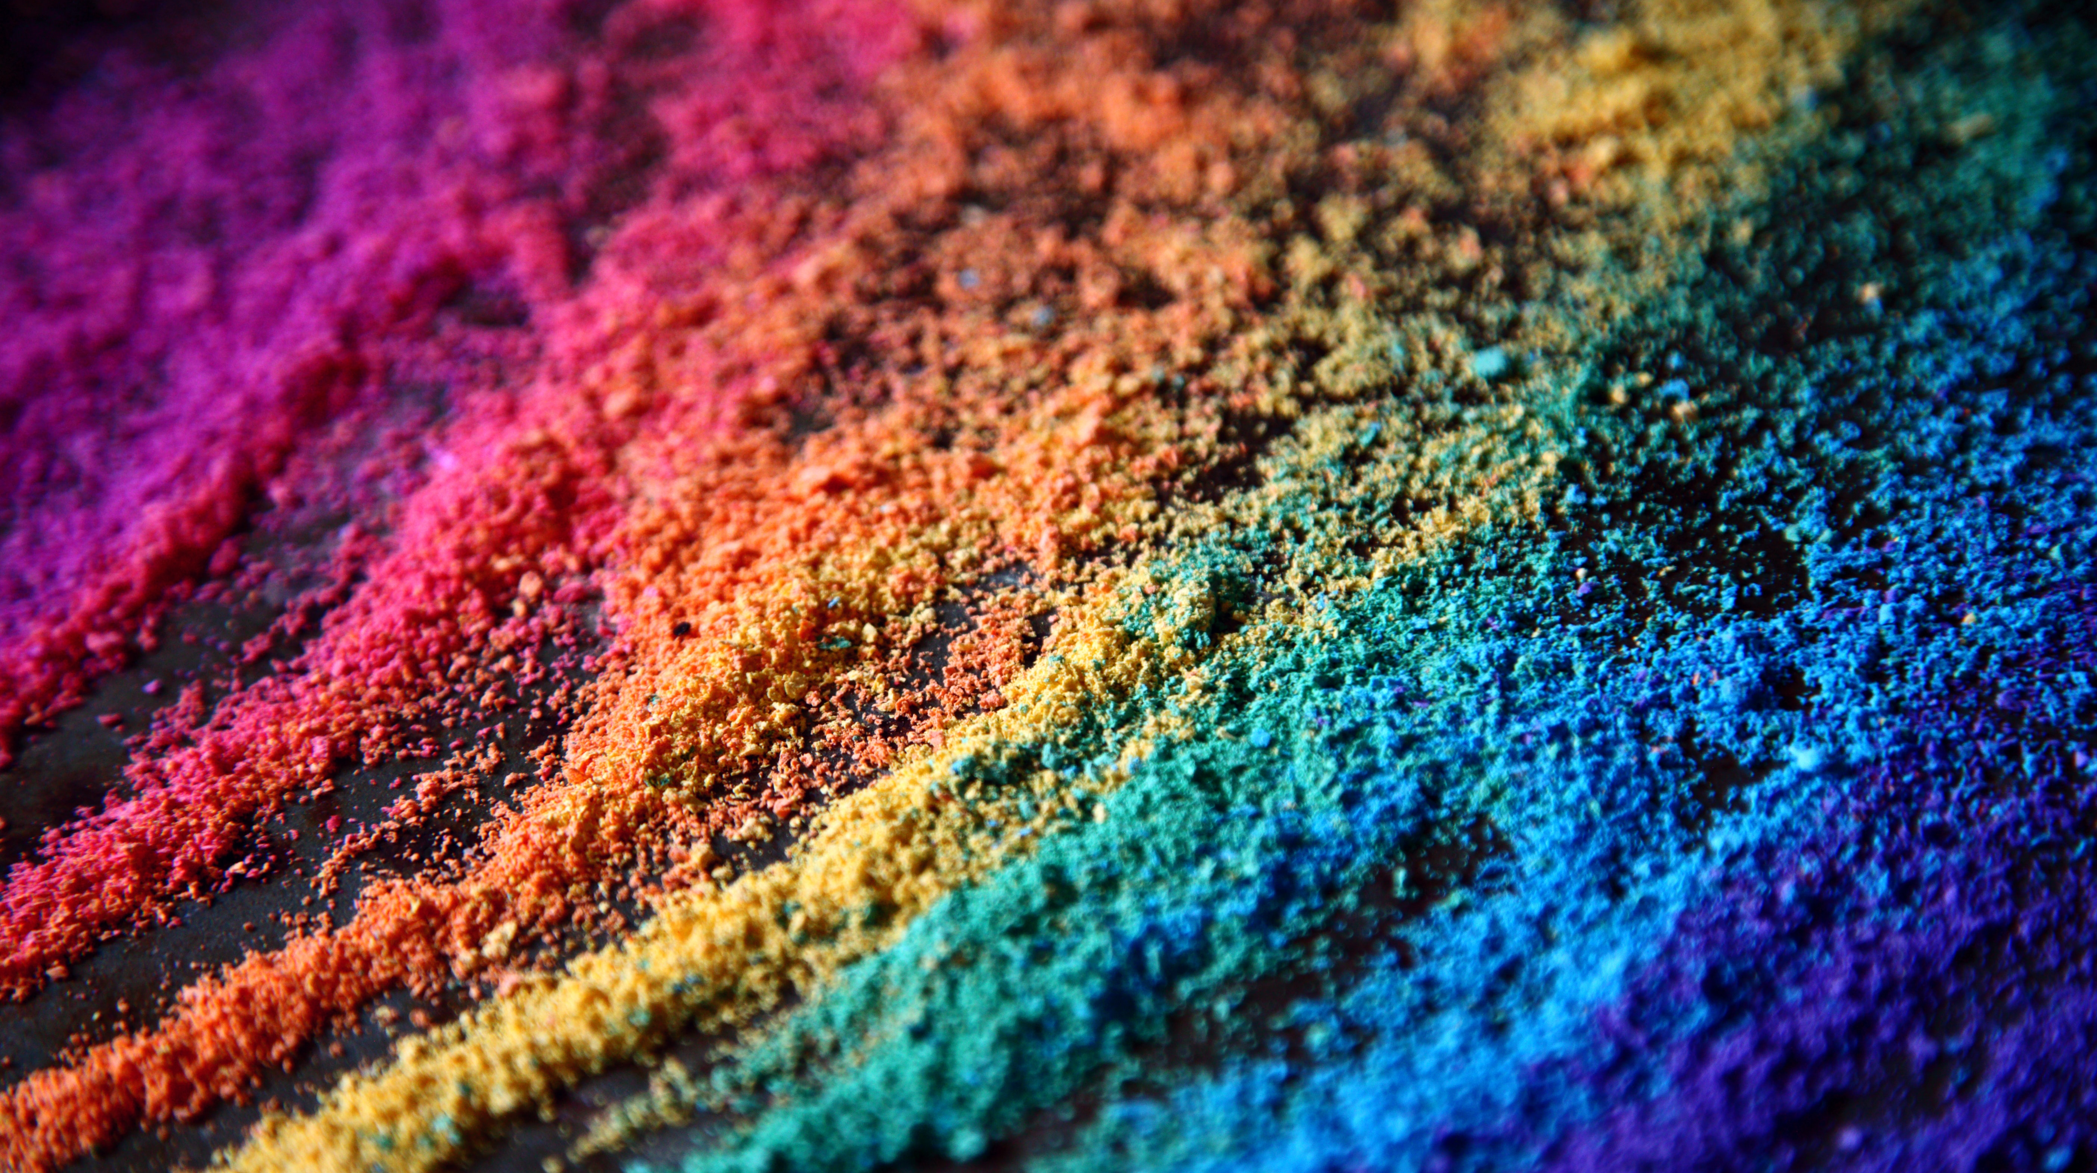
Questions?

